Slide 1
Final Year Project: Week 11 of 20
Marij Qureshi 16th Jan 2020
Robust Optimisation of Composite Panels

Slide 2
Progress
Objective 3: Robust Optimisation
Model completed + running – first results
Automation of Isight for algorithm tuning
Made significant headway + still going

Slide 3
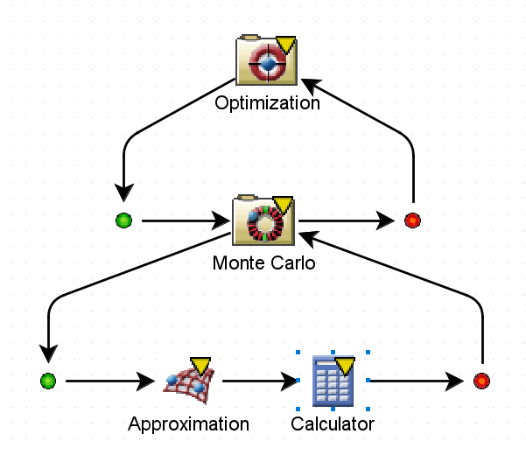
Robust optimisation - model
Options in Isight:
Explicit loop
Six-sigma
Taguchi design
Custom objective function
Export to MATLAB for post-processing

Slide 4
Robust optimisation – design results
General results
Deterministic vs Robust
Method comparison
Tuning (adaptive DOE)
Better comparison metrics

Slide 5
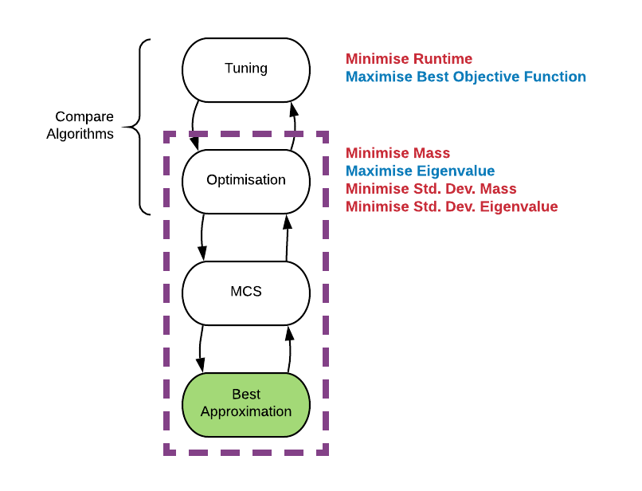
Tuning
Isight: Can’t manipulate optimisation parameters
Options:
Automate Isight
Run on separate script
Manual

Slide 6
Isight automation problem - tuning
Performance: untuned vs manual tuned vs full tuned
Full parameter study needed
Automation needed
Limitations of software

Slide 7
Isight automation - progress
Isight command line approach
Command line fipercmd from cmd
Python edit parameters
Batch file
Python functions
Languages: cmd, batch, Jython

Slide 8
Next steps
Tune # monte-carlo sims for accurate statistical analysis
Finish Isight automation – proper tuning for more valid results
Investigate discrete lay-up optimisation
Start to focus more on synthesis + write-up

Slide 9
Questions
Further analysis for project – algorithm comparison
Can’t extract algorithm source code
Making algorithm code way too hard
Best to illustrate is description, flowcharts + simple example program?
Report general considerations?

Slide 10
Progress
Case 1: Plate with hole
Case 2: Deterministic mono-string
Case 3: Robust mono-string
Main Objectives
Final Report Work
Workflow set-up and learning
Program efficiency + validation
Results validation + analysis
Auxiliary Objectives
Wks 17-19
Wks 1-3
Wks 4-9
Wks 10-15
Week | 1 | 2 | 3 | 4 | 5 | 6 | 7 | 8 | 9 | 10 | 11 | 12 | 13 | 14 | 15 | 16 | 17 | 18 | 19
Month | Jan |  | Feb |  |  |  | Mar |  |  |  |  | Apr |  |  |  | May

Slide 11
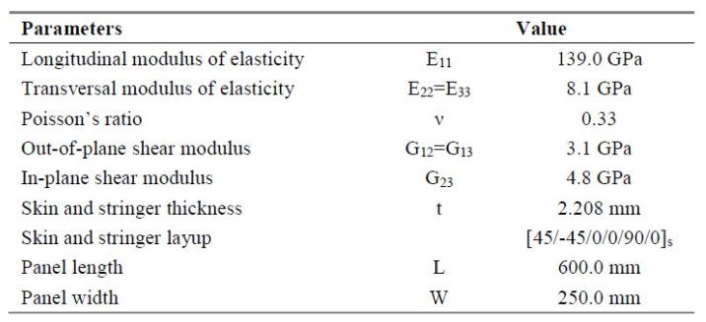
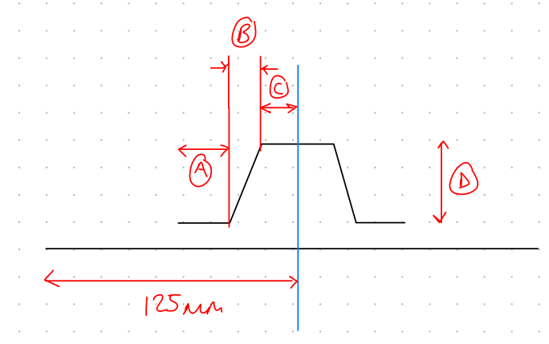
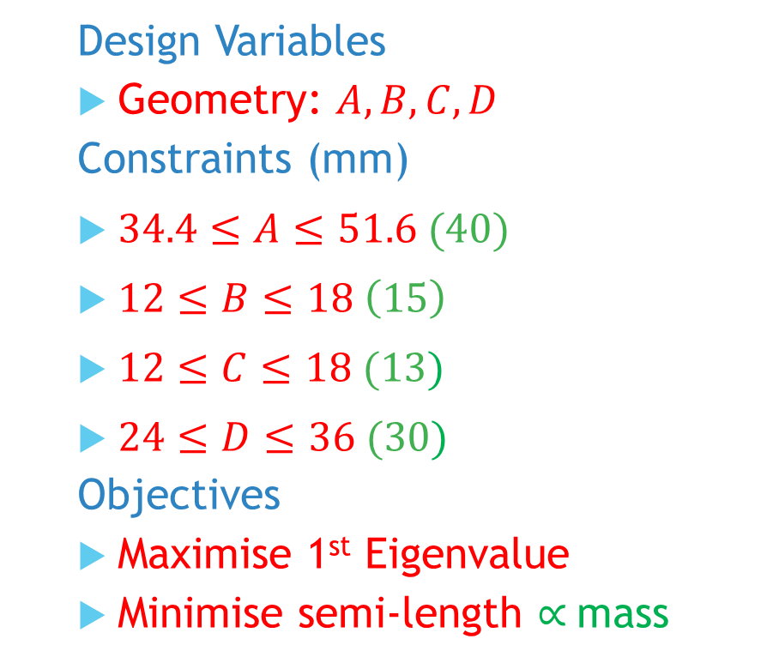
Mono-string: Problem
Design Variables
Geometry: $A,B,C,D$
Constraints (mm)
$34.4≤A≤51.6 (40)$
$12≤B≤18 \left(15\right)$
$12≤C≤18 (13)$
$24≤D≤36 (30)$
Objectives
Maximise 1st Eigenvalue
Minimise semi-length $∝$mass
Notes:
Post-buckling reliability design (vary lay-up)
Chapter 7: Robust Multilevel Design Optimization of Composite Panels
Robust and Reliability-Based Design Optimization of a Composite Floor Beam

